Slide 1
Native iOS, Android, Mac, & Windows Mobile Apps in C# with Xamarin
Monica Beate Tvedt
Software Engineer – Head of UMS Innovation Center
mbt@ums.no

Slide 2
Xamarin – Your Complete Mobile Solution
DESIGN – DEVELOP - INTEGRATE
TEST
MONITOR
LEARN
Notes:
Xamarin is your complete mobile solution.
Xamarin Platform is usually what you hear about which is building native iOS, Android, Mac, and Windows Apps all in C#
However Xamarin offers a wide range of products for developers to go mobile including Test Cloud, Insights, and a way to learn all of mobile with University.

Slide 3
Xamarin 4: the complete mobile lifecycle
BUILD
TEST
MONITOR
ACCELERATE
Notes:
Xamarin is your complete mobile solution.
Xamarin Platform is usually what you hear about which is building native iOS, Android, Mac, and Windows Apps all in C#
However Xamarin offers a wide range of products for developers to go mobile including Test Cloud, Insights, and a way to learn all of mobile with University.

Slide 4
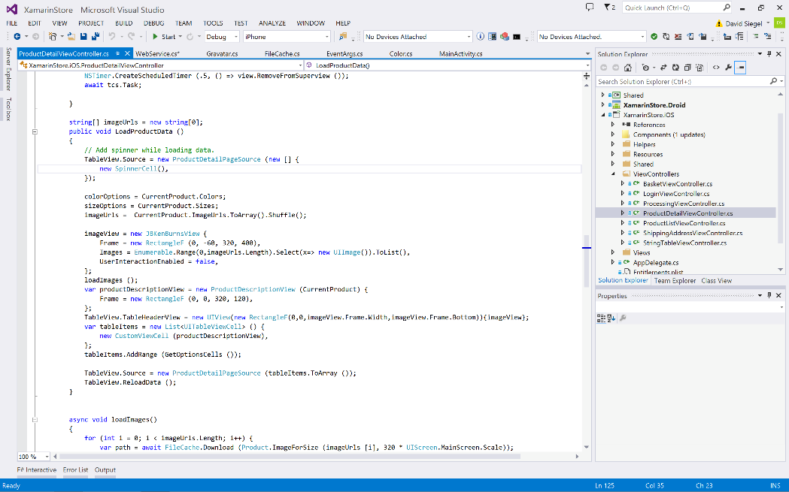
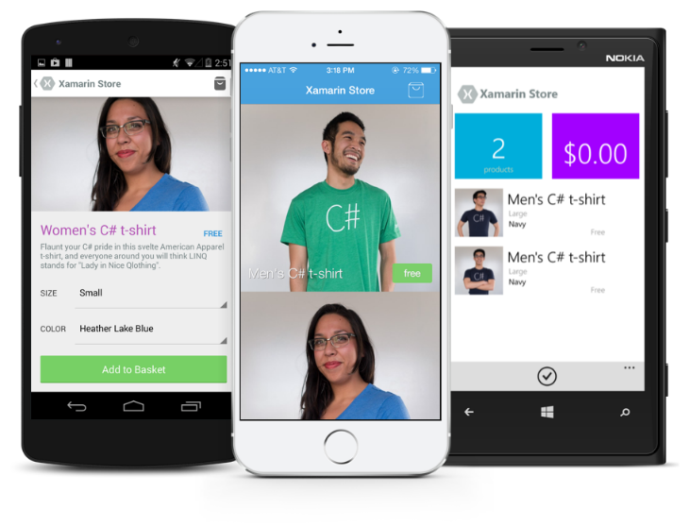
Xamarin Platform: native apps across platforms

Slide 5
What is Native?
Notes:
What makes up a “Native” mobile application? I am sure you have heard the “native” thrown around, but what does that really mean?

Slide 6
Native User Interfaces
Native API Access
Native Performance
Notes:
A native app needs a lot of things, but three important ones stick out:
Native User Interface: Apps need to look and act correct per platform.
Full SDK Access: As a developer we need to add the latest and greatest features
Native Performance: Needs to be fast and fluid

Slide 7
Notes:
Instant Articles was recently released by Facebook for browsing articles on the iPhone and it is a beautiful native experience with great animations taking advantage of the great look of iOS. To prove the point on how important native is read this quote.

Slide 8
“Not only is native mobile code winning for app development, but with things like Instant Articles, native is making the browser-based web look like a relic even just for publishing articles.”
-John Gruber
http://daringfireball.net/2015/05/facebook_instant_articles

Slide 9
Architecting Mobile Apps
Notes:
So we know what we want how do we get there? Let’s talk about the state of mobile development.

Slide 10
Silo Approach
iOS
Android
Windows
Objective-C
Xcode
Java
Android Studio
C#
Visual Studio
No shared code • Many languages & development environments • Multiple teams
Notes:
Multiple Teams
Multiple Code Bases
Expensive & Slow
Positive = Great apps delivered to user’s platform
Negative = Development hampered by multiple code bases & fragmentation

Slide 11
Write Once, Run Anywhere
Lua
Javascript
Actionscript
HTML+CSS
App Generator
Limited native API access • Slow performance • Poor user experience
Notes:
Unhappy Users
Unhappy Developers
Increase in Abandoned Apps
Limited to what is implemented

Slide 12
Xamarin’s Unique Approach
iOS C# UI
Android C# UI
Windows C# UI
Shared C# Mobile
Shared C# codebase • 100% native API access • High performance
Notes:
UI build natively per platform, leveraging C#
C# + XAML
C# + XML
C# + XIB
One shared app logic code base, iOS, Android, Mac, Windows Phone, Windows Store, Windows

Slide 13
Xamarin + Xamarin.Forms
iOS C# UI
Android C# UI
Windows C# UI
Shared UI Code
Shared C# Backend
Shared C# Backend
Traditional Xamarin Approach
With Xamarin.Forms: More code-sharing, all native
Notes:
Xamarin recently introduced Xamarin.Forms a new library for cross platform user interface. We will touch up on this later, but this enables you to be highly productive, share code, but build out UI on each platform and access platform APIs.
With Xamarin.Forms you now have a nice Shared UI Code layer, but still access to platform APIs
You can start from native, pick a few screens, or start with forms, and replace with native later

Slide 14
Xamarin’s Unique Approach
iOS C# UI
Android C# UI
Windows C# UI
Azure
Linux/Mono
CoreCLR
Shared C# Mobile
C# Server
Shared C# Client/Server
Shared C# codebase • 100% native API access • High performance
Notes:
With Xamarin it just isn’t your front end in C# it is your full backend server as well. With Azure or even on Linux running Mono or the CoreCLR your app is fully C# end to end!

Slide 15
Why C#?
Notes:
Let’s talk a bit about C# and why it is awesome.

Slide 16
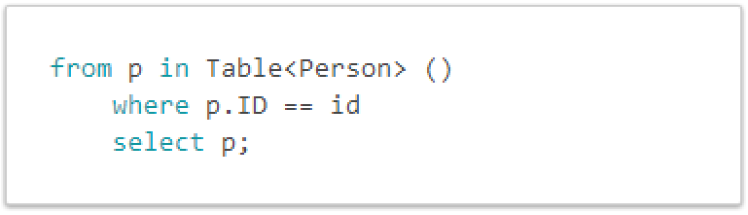
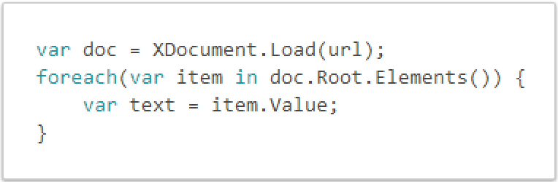
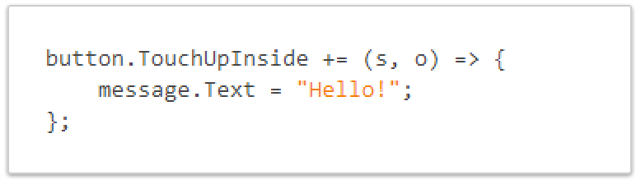
C# is Awesome
LINQ Support
Work with XML Easily
Event Handling & Delegates

Slide 17
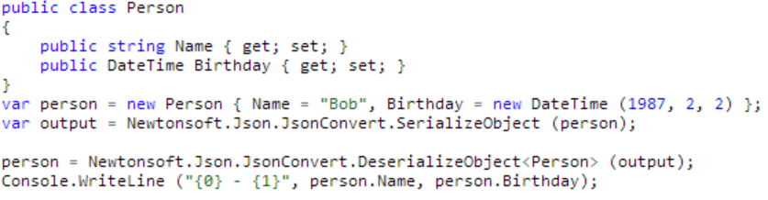
JSON Made Easy
Json.NET offers simple conversations to/from JSON strings and .NET objects:
Notes:
Use your favorite libraries like Json.NET!

Slide 18
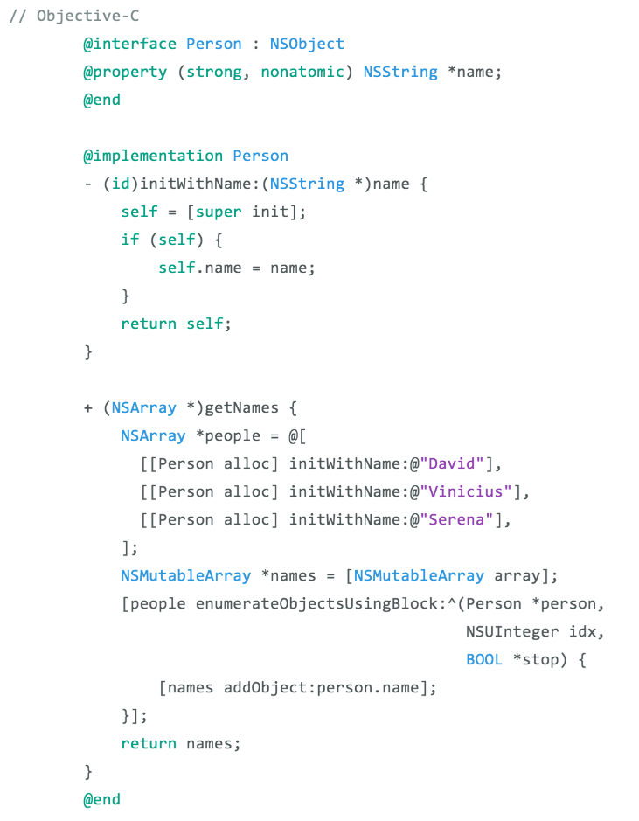
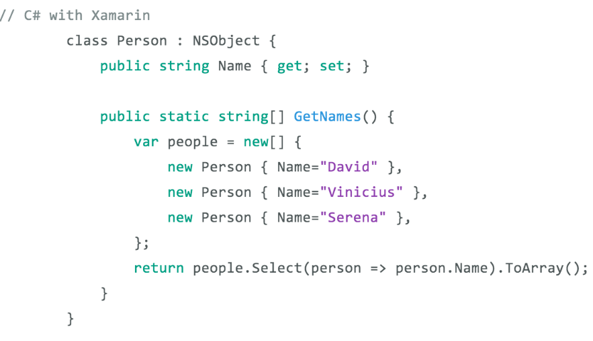
See the Different – Classes & Methods
Notes:
Here is an example of creating a class with a method to get names
1 Line with LINQ to execute this command
Take advantage of C# features and set properties easily

Slide 19
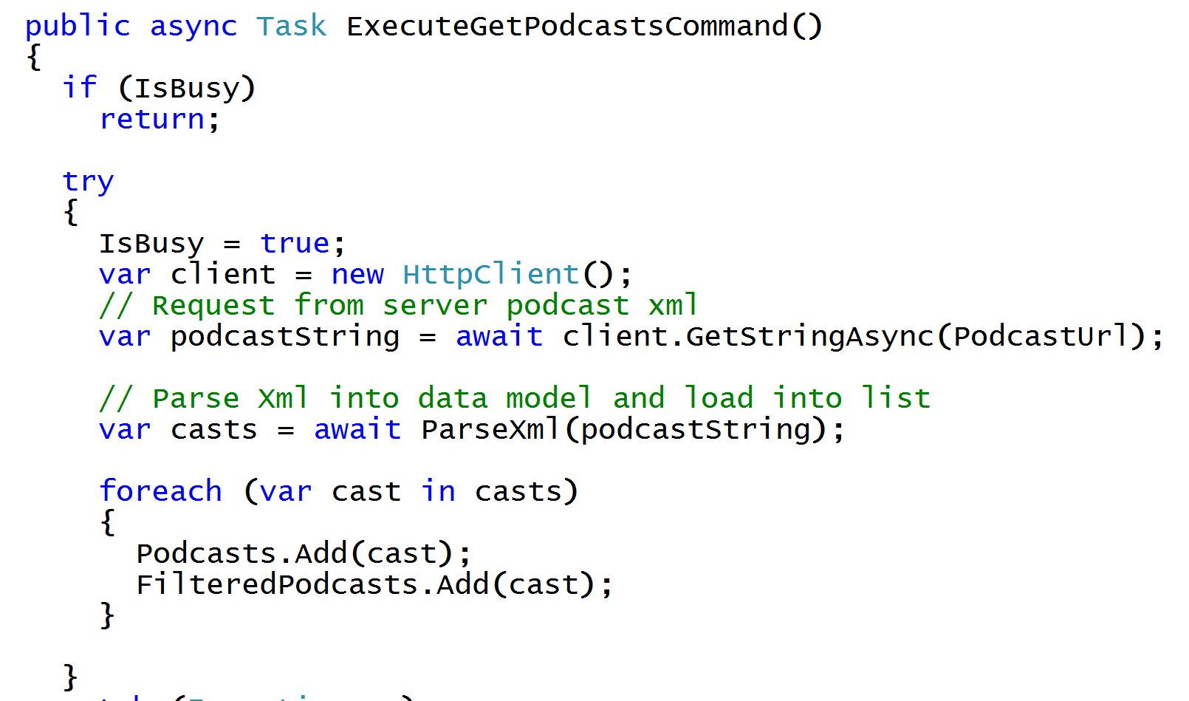
Async/Await
Write Beautiful & Maintainable Code
Notes:
The async and await keywords in C# 5.0 now available to Xamarin developers make asynchronous programming incredibly pleasant.
You end up with code that is much more linear and much easier to understand.
The compiler does a lot of magic for you which simplifies your code and your life.

Slide 20
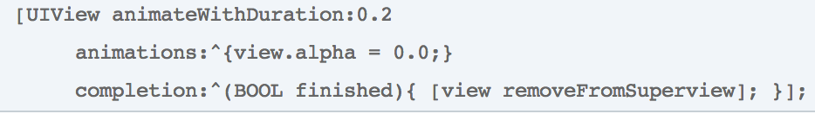
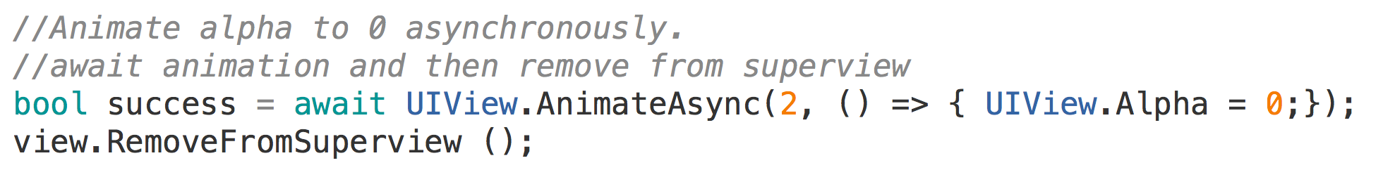
Simplifying Native Methods with Async/Await
Objective-C
C# with Xamarin
Notes:
With Xamarin we even extend native methods with C# Features
Here there is no need for a callback block, simply await on the animation to finish before continuing on

Slide 21
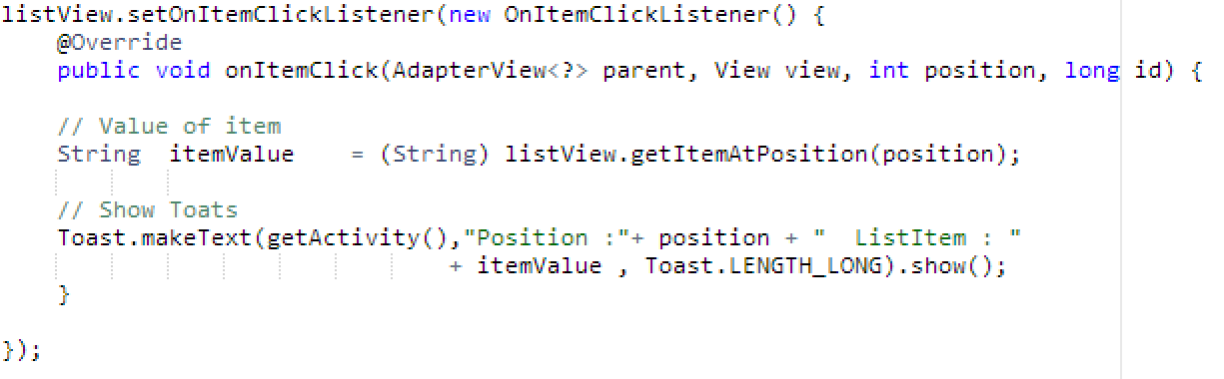
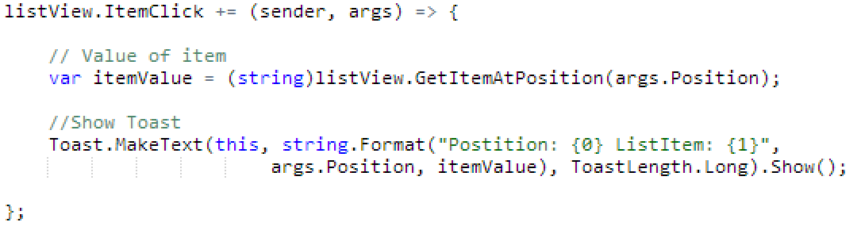
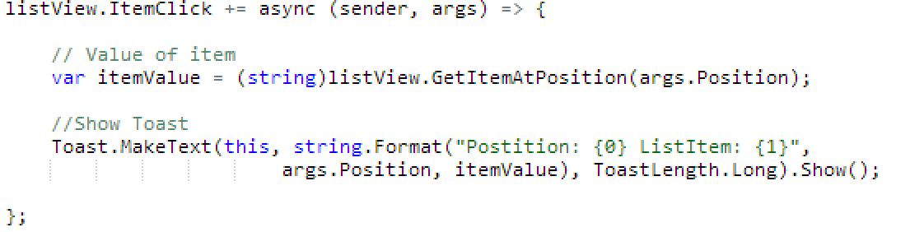
See the Difference – Android ItemClick
Java
C# with Xamarin
C# & Async with Xamarin
Notes:
Here we can see how easy it is just to do a += for an event and not have to implement a bunch of listeners every time. Easy to read, string.Format, using args, etc.
In fact we can make this call Async/Await by just adding async to the delegate!

Slide 22
Why Xamarin?

Slide 23
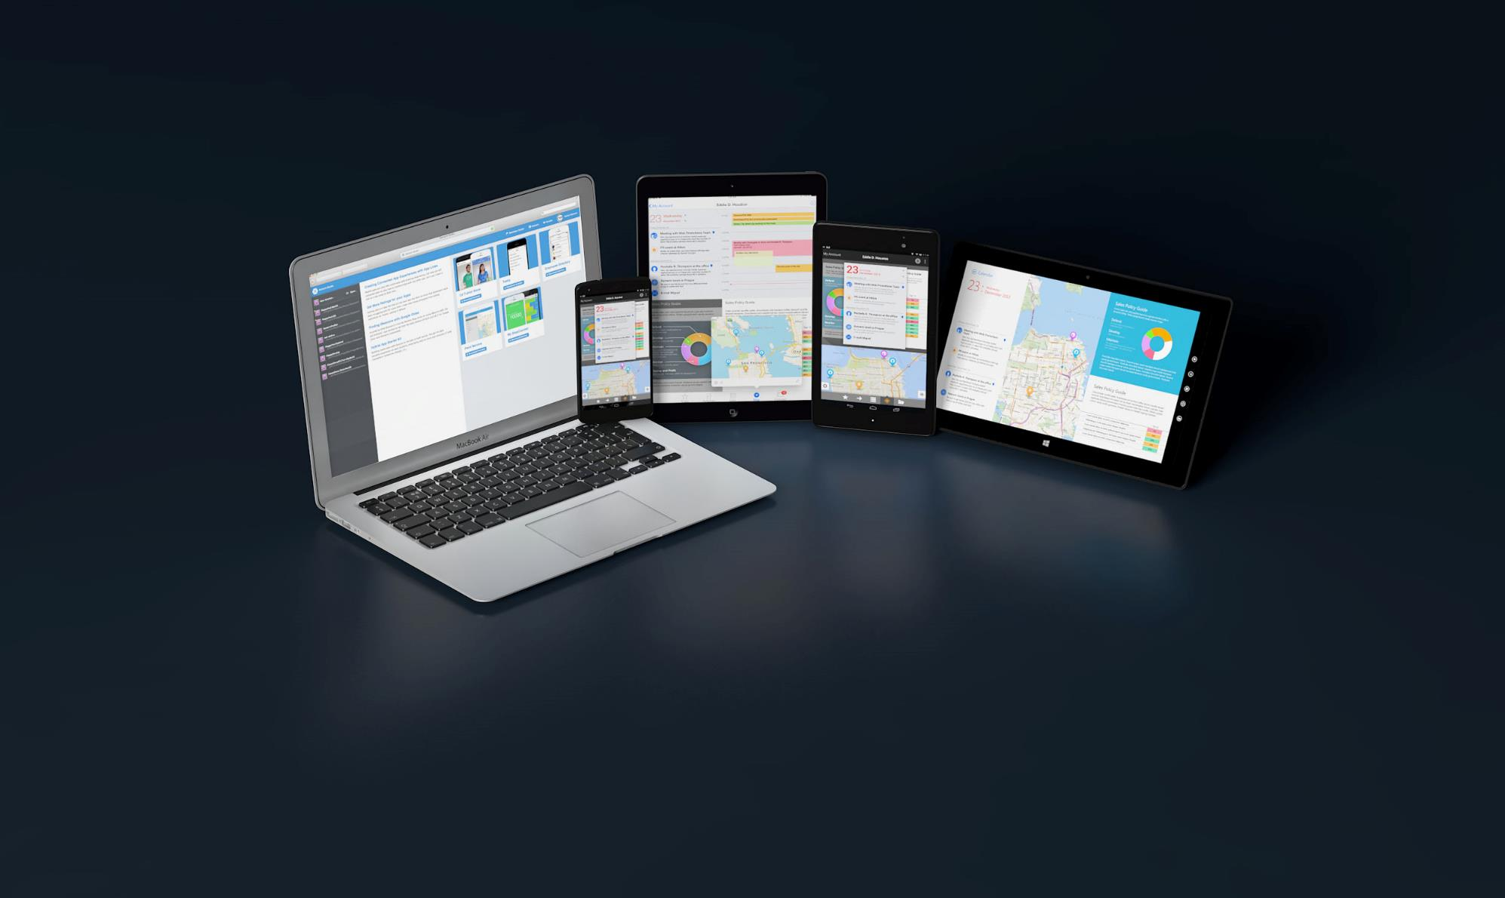
Write Everything in C#
C# Now Runs on 2.6+ Billion Devices

Slide 24

Microsoft and Xamarin Partnership
“With Xamarin, developers combine all of the productivity benefits of C#, Visual Studio and Windows Azure with the flexibility to quickly build for multiple device targets.”
S. Somasegar, Corporate Vice President, Microsoft
Notes:
Another partnership at the end of 2014:
Support for VS 2015 + Community Edition
Special MSDN Offers
Starter Edition Support for Visual Studio
Kjøpt opp av Microsoft - gratis

Slide 25
How Xamarin Works

Slide 26
Windows APIs
Microsoft.Phone
Microsoft.Networking
Windows.Storage
Windows.Foundation
Microsoft.Devices
System.Net
System
System.IO
System.Linq
System.Xml
System.Data
System.Windows
System.Numerics
System.Core
System.ServiceModel
Notes:
If you have ever developed for a Windows Platform before these .NET namespaces might look familiar.
However, if we go to a new platform such as Windows Phone or Store we have a new SDK to use and a new set of namespaces.

Slide 27
iOS – 100% API Coverage
MapKit
UIKit
iBeacon
CoreGraphics
CoreMotion
System.Net
System
System.IO
System.Linq
System.Xml
System.Data
System.Windows
System.Numerics
System.Core
System.ServiceModel
Notes:
You can think of iOS and Android development the same with Xamarin. You can see we have all of our .NET namespaces and libraries, but Xamarin give us 100% api coverage of each iOS API in it’s SDK that we access view C#.

Slide 28
Android – 100% API Coverage
Text-to-speech
ActionBar
Printing Framework
Renderscript
NFC
System.Net
System
System.IO
System.Linq
System.Xml
System.Data
System.Windows
System.Numerics
System.Core
System.ServiceModel
Notes:
The same is true for Android as well.

Slide 29
Anything you can do in Objective-C, Swift, or Java can be done in C# and Visual Studio with Xamarin.

Slide 30
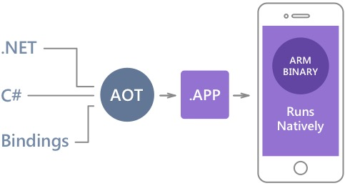
Native Performance
Xamarin.iOS does full Ahead Of Time (AOT) compilation to produce an ARM binary for Apple’s App Store.
Xamarin.Android takes advantage of Just In Time (JIT) compilation on the Android device.
Notes:
There is no compromise on performance.
Xamarin apps look and feel native because they are native.

Slide 31
✓Always Up-to-Date
Same-day support:
iOS 5
iOS 6
iOS 7
iOS 7.1
iOS 8
iOS 9
Full support for:
Apple Watch
Apple TV
Google Glass
Android Wear
Amazon Fire TV
and much more
Notes:
Apple has a developer preview where Xamarin has alphas ready. Google does not offer this.
Android versions are usually 4 to 8 weeks out for a stable release, but alphas and betas are usually earlier.
Xamarin realizes how important having iOS ready because within 24 hours a large portion of iOS users upgrade
Android on the other hand is much different. After 4 months on the market Android 4.4 only had 1% adoption

Slide 32
Sharing Code

Slide 33
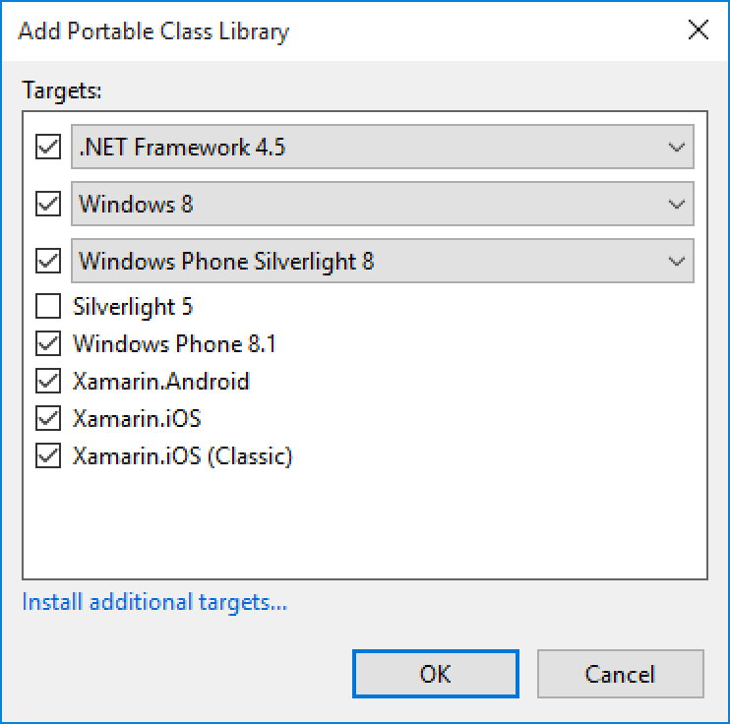
Portable Class Libraries
1 Assembly
Multiple Platforms
Including:
Xamarin.iOS and Xamarin.Android

Slide 34
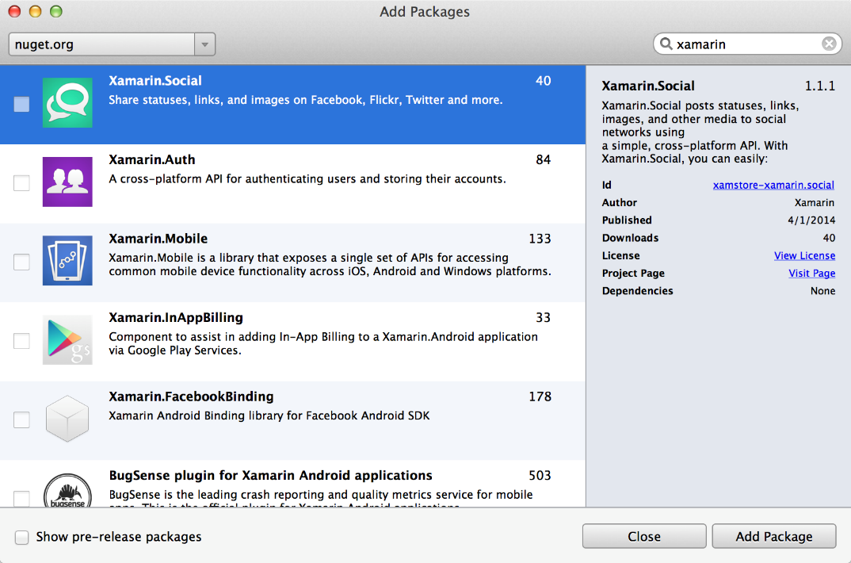
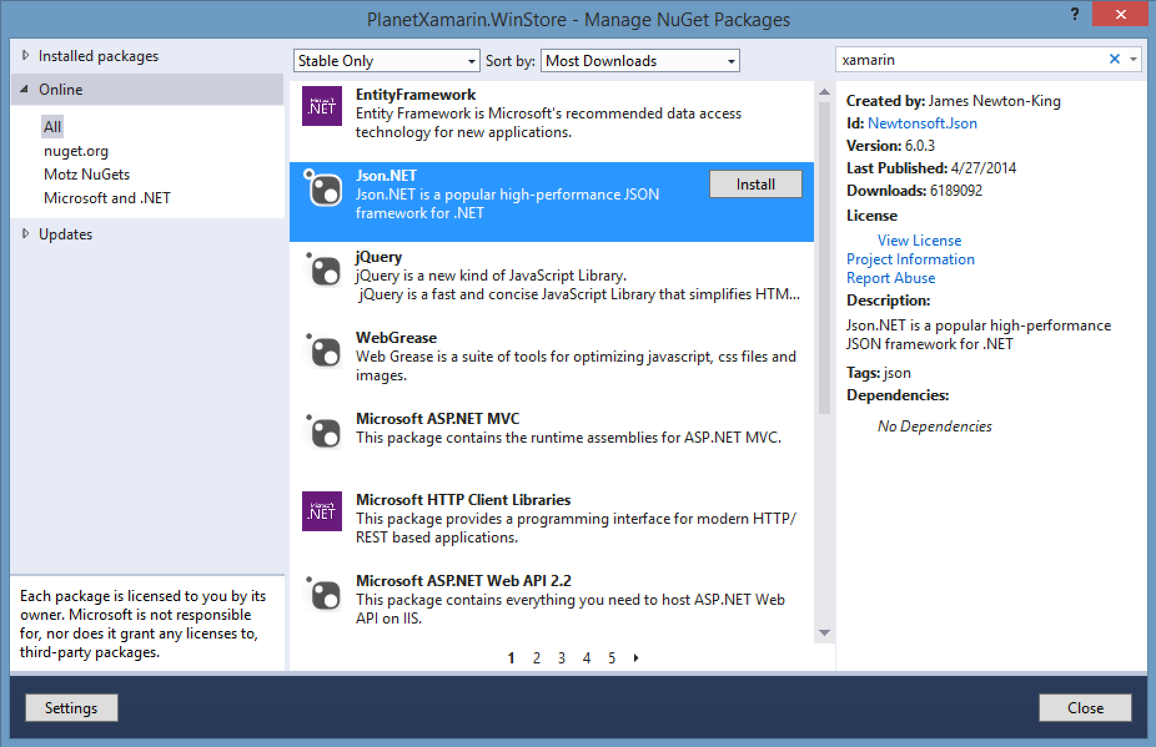
NuGet
Notes:
Use all of your favorite libraries from NuGet or share and distribute your own!

Slide 35
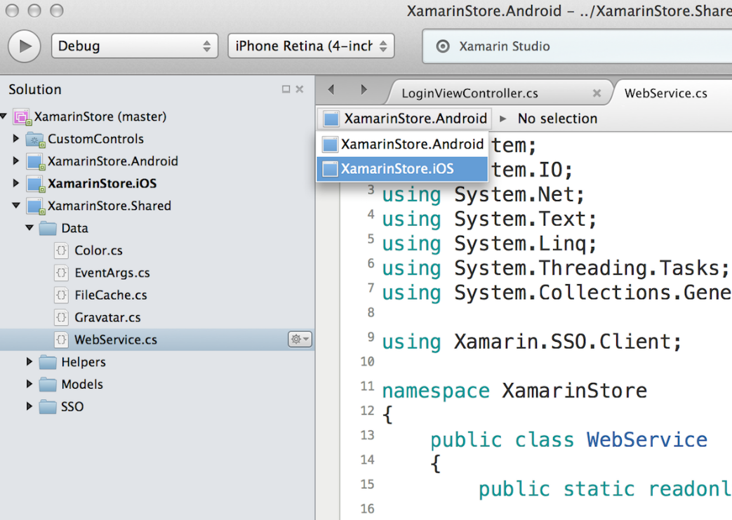
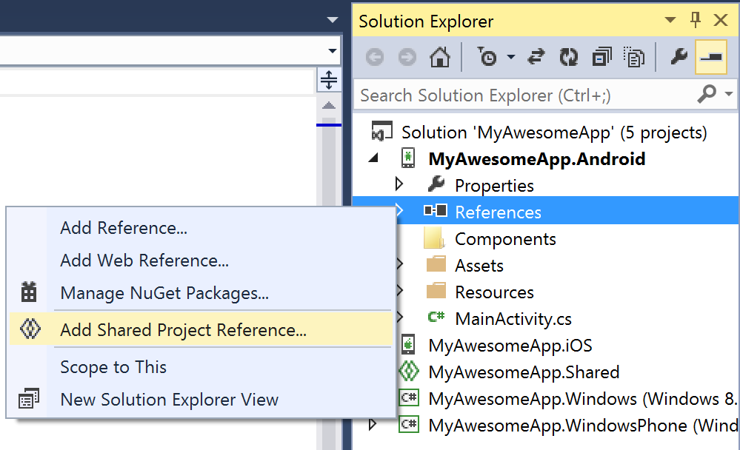
Shared Projects

Slide 36
Code Sharing Stats
iCircuit
Touch Draw
Android
iOS
Mac
Windows Phone
Notes:
iCircuit is made by Frank Krueger, a long time Mono & Xamarin developer.
Sharing code lead to 70 to 90% code reuse across platforms speeding up development
Real-time circuit simulator and editor used to design analog and digital circuits
http://praeclarum.org/post/42378027611/icircuit-code-reuse-part-cinq

Slide 37
Development Experience

Slide 38

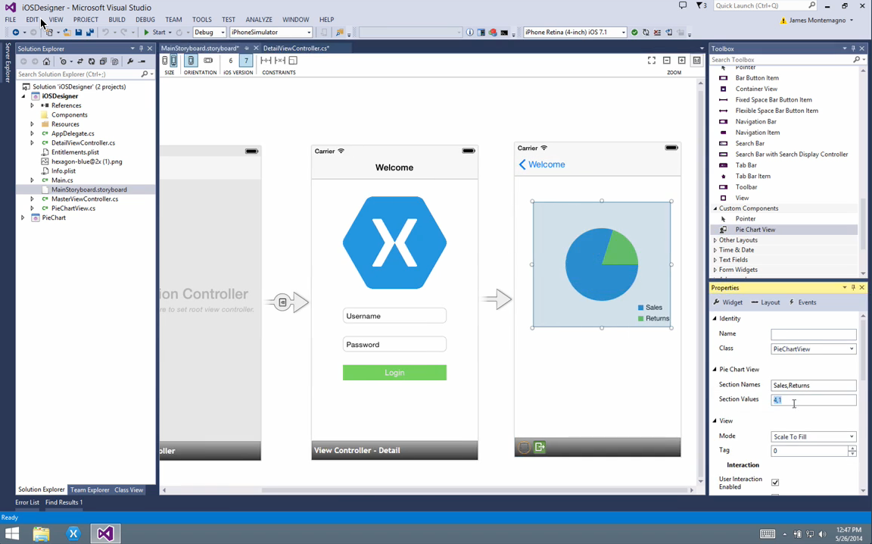
Visual Studio Integration
Notes:
Single Solution for iOS, Android, and Windows
Leverage Entire Microsoft Ecosystem:
ReSharper
Team Foundation Server
Azure
ASP.NET
Favorite Code Coverage and Profiling Tools
Starter Compatible
Visual Studio 2012, 2013, and 2015 including Community Edition

Slide 39

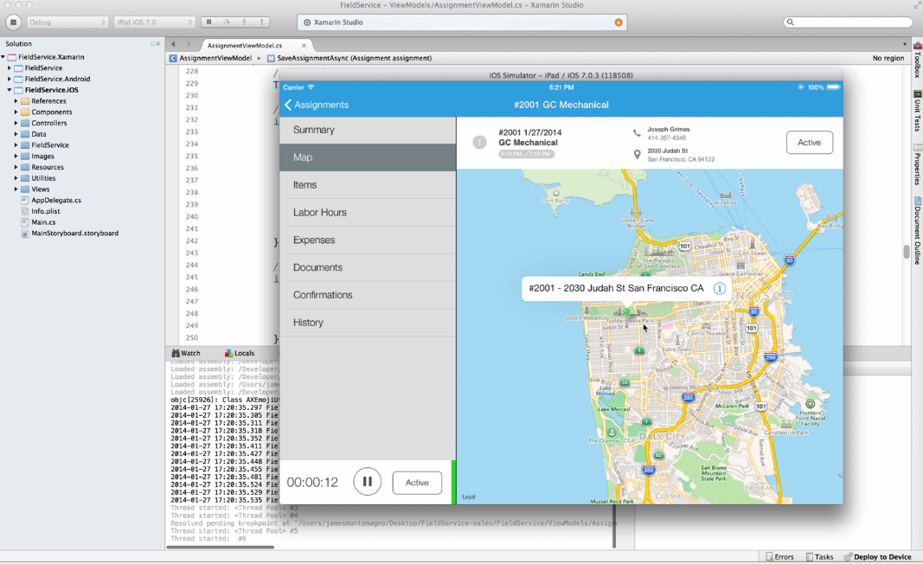
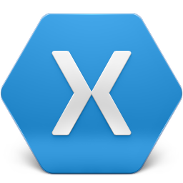
Xamarin Studio – Mac or PC
Notes:
Xamarin Studio is available for Android development on the PC.
Xamarin Studio on Mac offers: Android, iOS and Mac development
World Class IDE with great features:
Code Analysis
Upload to Test Flight
Git & Subversion Integration
Code Completion
Code Navigation
Easy transition from Visual Studio
The same Solution & Projects open in BOTH Xamarin Studio and Visual Studio!

Slide 40
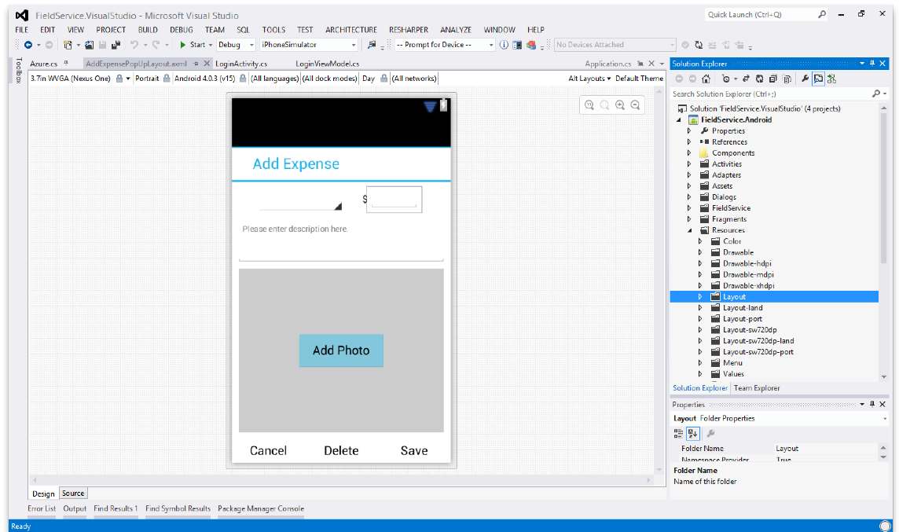
Android Designer
Available in:
Xamarin Studio
Visual Studio
Create UI with drag & drop simplicity
Target multiple screen sizes, resolutions and Android versions
Layouts saved in standard Android XML files

Slide 41
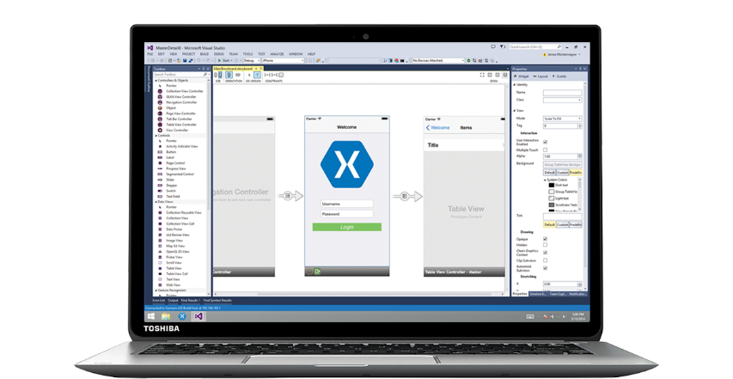
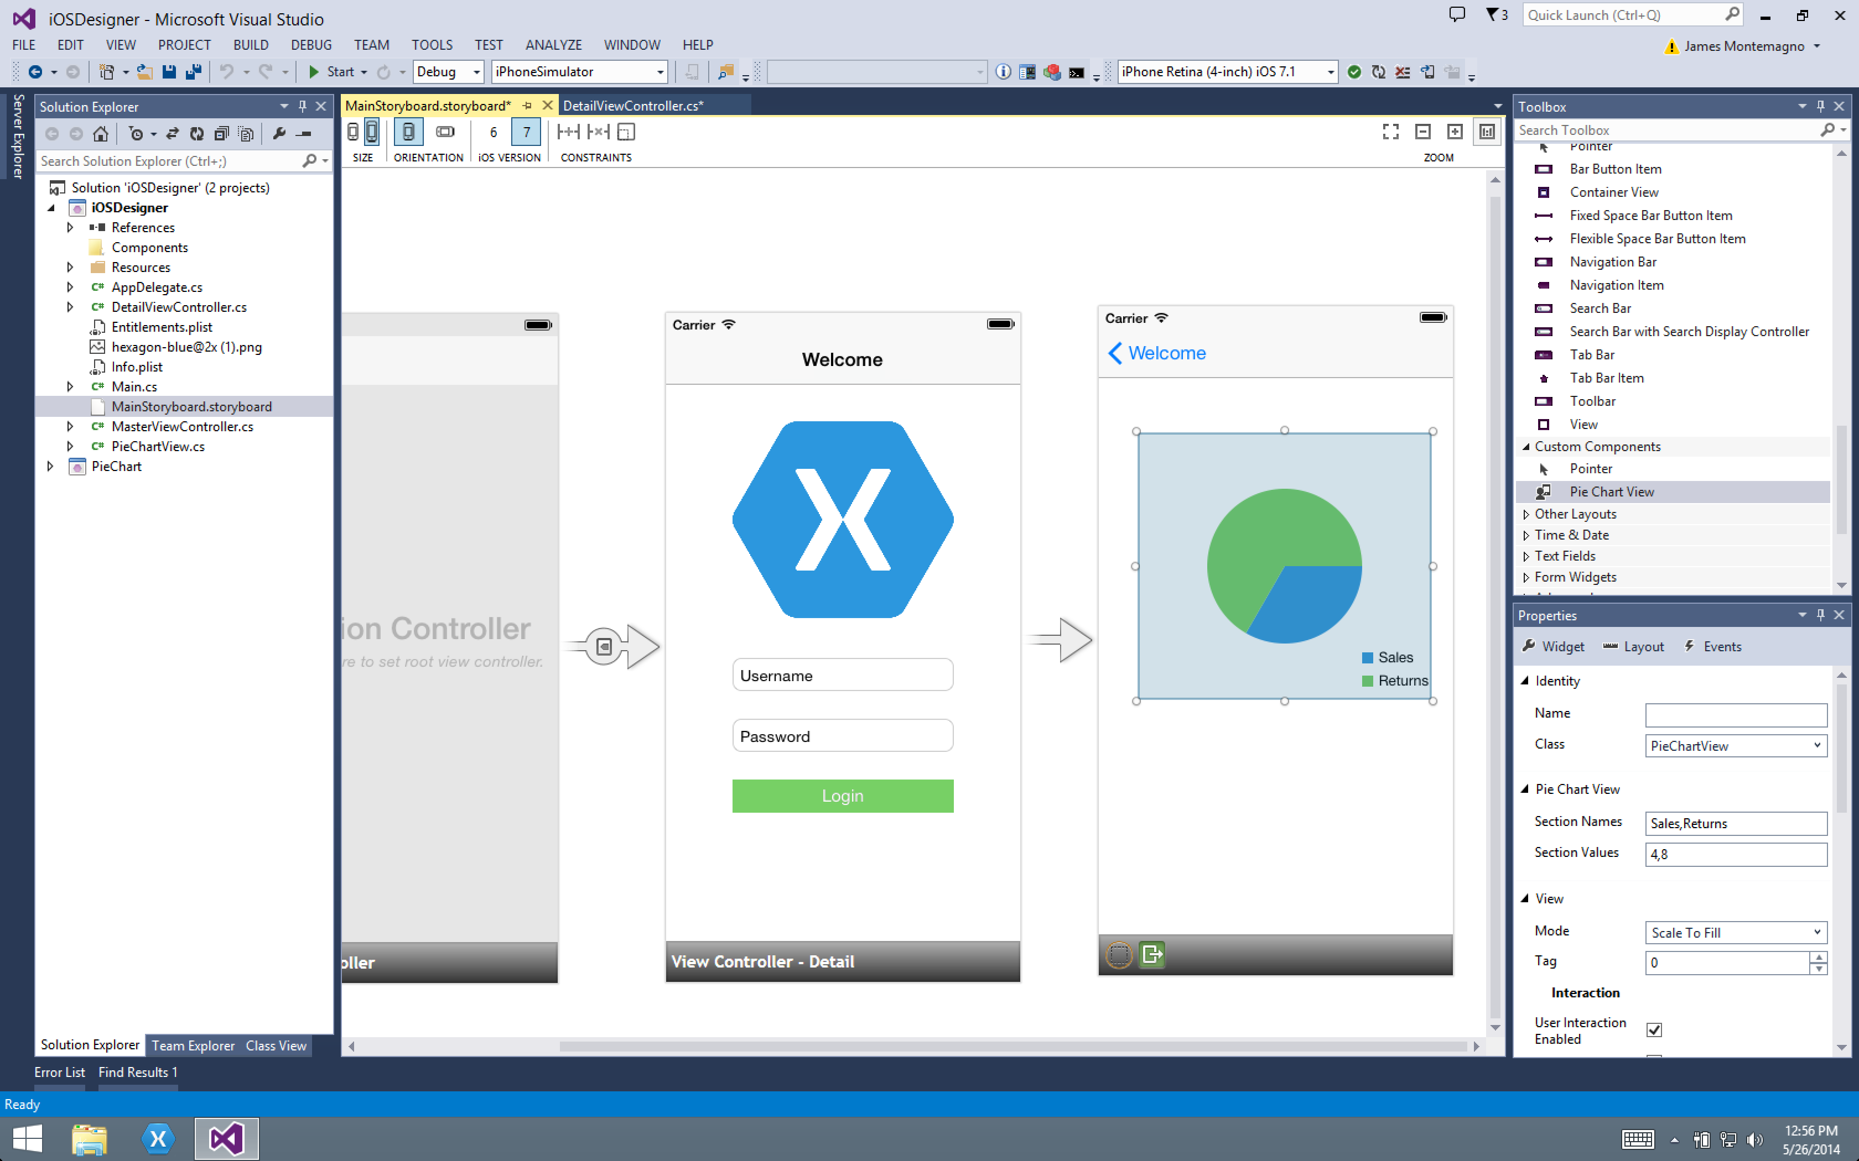
Xamarin Designer for iOS
World’s first iOS Designer available in Xamarin Studio and Visual Studio
Follows familiar Visual Studio designer idioms
Supports all UIKit elements
Edit custom and 3rd party components
Live preview of changes to properties

Slide 42
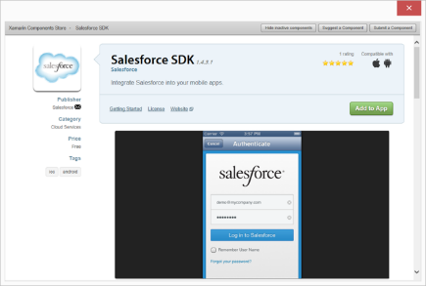
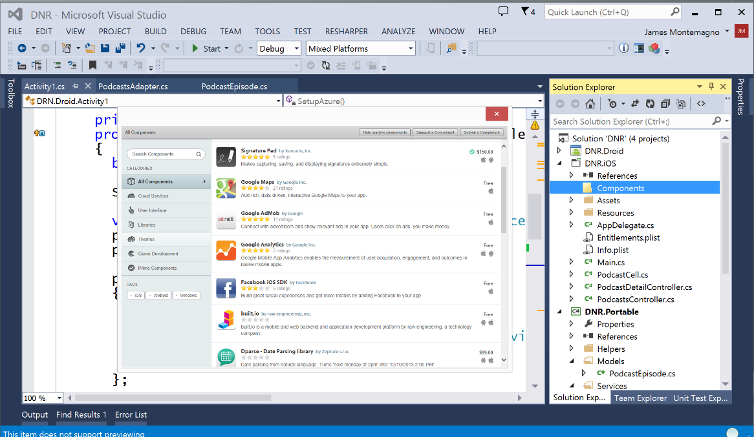
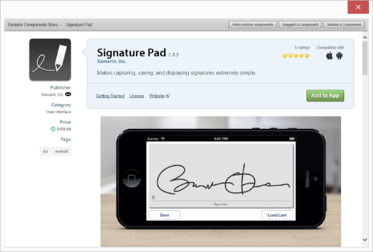
Xamarin Component Store
Build Apps Faster
Add high quality pre-built app components directly from Visual Studio and Xamarin Studio
Beautiful, cross-platform UI controls, cloud services, and enterprise backend integrations are just a few clicks away

Slide 43
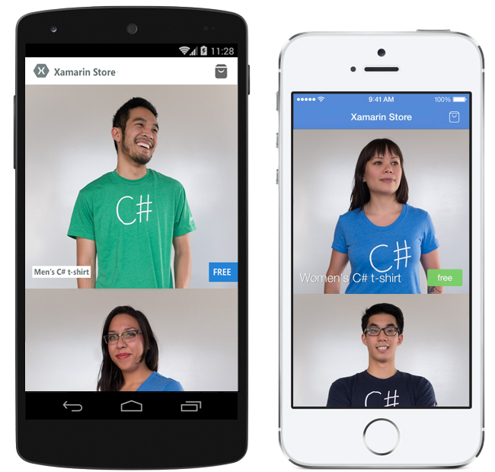


Pre-built App Templates
Xamarin.com/prebuilt
My Shoppe
Connect with consumers
Store Application
Moments
Photo Sharing App
Notes:
If you are looking to get started will a full baked application simply head over to Xamarin’s pre-built page featuring these apps and many more!

Slide 44
Let’s take a look

Slide 45
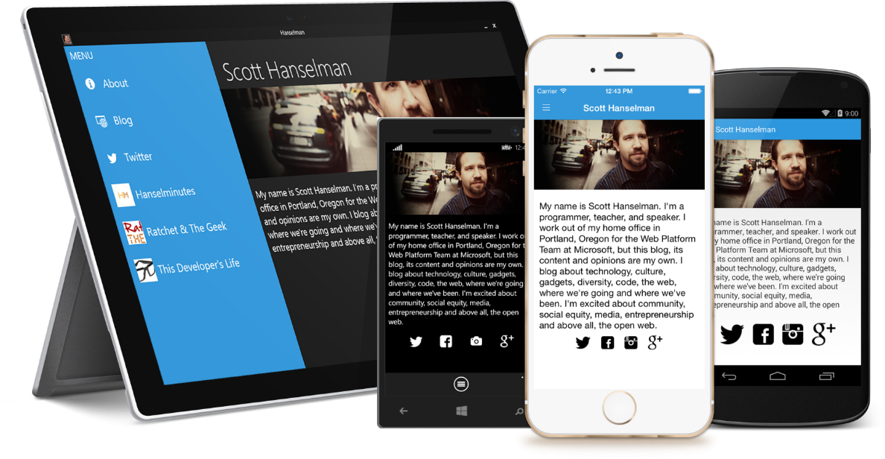
Meet Xamarin.Forms
Build native UIs for iOS, Android, and Windows Phone from a single, shared C# codebase.
Notes:
Xamarin Forms is a new set of APIs allowing you to quickly and easily write shared User Interface code that is still rendered natively on each platform, while still providing direct access to the underlying SDKs if you need it.

Slide 46
Xamarin + Xamarin.Forms
iOS C# UI
Android C# UI
Windows C# UI
Shared UI Code
Shared C# Backend
Shared C# Backend
Traditional Xamarin Approach
With Xamarin.Forms: More code-sharing, all native
Notes:
We see here the Xamarin approach we talked about earlier
This enables you to be highly productive, share code, but build out UI on each platform and access platform APIs
With Xamarin.Forms you now have a nice Shared UI Code layer, but still access to platform APIs
You can start from native, pick a few screens, or start with forms, and replace with native later

Slide 47
What’s included
✓ 40+ Pages, layouts, and controls
(Build from code behind or XAML)
✓ Two-way data binding
✓ Navigation
✓ Animation API
✓ Dependency Service
✓ Messaging Center
Shared UI Code
Shared C# Backend
Notes:
Xamarin.Forms is much more that just a framework and includes everything you need to get up and running to build out full native applications.
If you are used to MVVM type of development you will feel right at home.

Slide 48
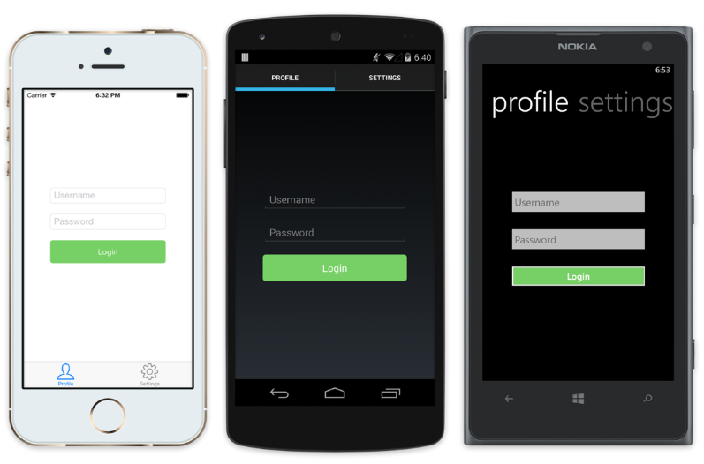
Native UI from shared code
<?xml version="1.0" encoding="UTF-8"?>
<TabbedPage xmlns="http://xamarin.com/schemas/2014/forms"
xmlns:x="http://schemas.microsoft.com/winfx/2009/xaml"
x:Class="MyApp.MainPage">
<TabbedPage.Children>
<ContentPage Title="Profile" Icon="Profile.png">
<StackLayout Spacing="20" Padding="20"
VerticalOptions="Center">
<Entry Placeholder="Username"
Text="{Binding Username}"/>
<Entry Placeholder="Password"
Text="{Binding Password}"
IsPassword="true"/>
<Button Text="Login" TextColor="White"
BackgroundColor="#77D065"
Command="{Binding LoginCommand}"/>
</StackLayout>
</ContentPage>
<ContentPage Title="Settings" Icon="Settings.png">
<!-- Settings -->
</ContentPage>
</TabbedPage.Children>
Notes:
Here is a quick example of a login page:
Notice the data binding on the Entries Text fields. Additionally, there is a LoginCommand.
Each has a native user interface

Slide 49






Which Xamarin approach is best for your app?
Xamarin.Forms is best for:
Xamarin.iOS / Xamarin.Android is best for:
Data entry apps
Prototypes and proofs-of-concept
Apps that require little platform-specific functionality
Apps where code sharing is more important than custom UI
Apps that require specialized interaction
Apps with highly polished design
Apps that use many platform-specific APIs
Apps where custom UI is more important than code sharing
Learn more: xamarin.com/forms
Learn more: xamarin.com/platform
Notes:
Pick what is right for you!
Xamarin has this nifty guide to help you decide to go traditional or with Xamarin.Forms

Slide 50

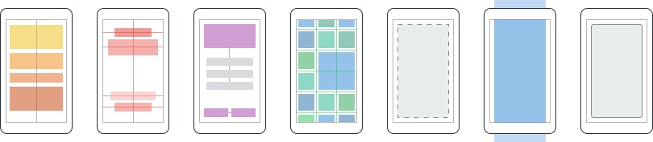
Layouts
Pages
Content
MasterDetail
Navigation
Tabbed
Carousel
Stack
Absolute
Relative
Grid
ContentView
ScrollView
Frame
Notes:
First you have a set of pages for each screen of your application
There are things like Content, and MasterDetail which gives you a nice flyout
With a tabbed view you get the correct look on each platform
iOS on bottom, Android on top, and on WP you have a Pivot control
Inside of a page are layouts
A lot of options from something simple like a stack panel to complex and powerful grids

Slide 51
Controls
ActivityIndicator
BoxView
Button
DatePicker
Editor
Entry
Image
Label
ListView
Map
OpenGLView
Picker
ProgressBar
SearchBar
Slider
Stepper
TableView
TimePicker
WebView
EntryCell
ImageCell
SwitchCell
TextCell
ViewCell
Notes:
You have more than 40 controls, layouts, and pages to mix and match from.
These are all of the controls you have out of the box, you can of course create your own.
What is unique is you get the native control and have access to it.
Consider an Entry Field
On iOS it is mapped to UITextField
Android it is EditText
Windows Phone it is a TextBox

Slide 52


Xamarin.Forms Ecosystem
Notes:
Xamarin.Forms also has a great ecosystem of controls from vendors you might know!

Slide 53
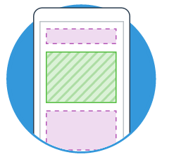
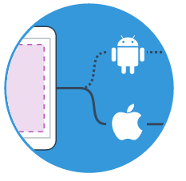

Extensibility
Embed Custom Views Anywhere
Not only are Xamarin.Forms pages mixable with custom screens, you can embed custom views built directly against Xamarin.iOS and Xamarin.Android into Xamarin.Forms pages.
Call Platform APIs via Shared Services
Need platform-specific functionality within a Xamarin.Forms page, such as querying the accelerometer? We’ve included services that quickly and easily abstract platform-specific API calls to keep you writing as much shared code as possible.
Easy migration to the Xamarin Platform
When your native platform integration requirements outgrow Xamarin.Forms, your shared code is easily migrated to Xamarin.iOS and Xamarin.Android using the full Xamarin platform.
Notes:
With Xamarin.Forms you can easily extend and embed custom views, mix and match screens, called native apis, or even easily migrate to a traditional app and share your backend logic.

Slide 54
Plugins for Xamarin
Notes:
A unique aspect of Xamarin.Forms is an abstraction over the user interface, but what about the platform specific functionality that makes these devices so special?
That is where plugins for Xamarin come in.

Slide 55
Shared C# Backend
Notes:
What is this stuff that we talk about up here?

Slide 56
Platform Specific Code
UI+APIs
UI + APIs
UI + APIs
Battery
GPS
Lights
Notifications
Settings
Text To Speech
Battery
GPS
Lights
Notifications
Settings
Text To Speech
Battery
GPS
Lights
Notifications
Settings
Text To Speech
What if we didn’t have to write this code?
What if we could access it from shared code?
Notes:
This is the platform specific code no matter how you are developing traditional Xamarin or with Xamarin.Forms.
However, many platform APIs are the same bit of functionality, but with different APIs.
What if we had 1 API?

Slide 57
Speak(“Hello World”);
AVSpeechSynthesizer
TextToSpeech
SpeechSynthesizer
Notes:
For instance text to speech, what if we could just say “Speak” and it would speak text with the underlying API.

Slide 58
Plugins for Xamarin
github.com/xamarin/plugins
Common API
Notes:
This is what Plugins for Xamarin are for! 1 API for all common APIs:
Camera
GPS
Settings
Notifications
Battery
And so much more!

Slide 59
Xamarin – Your Complete Mobile Solution
BUILD
TEST
MONITOR
ACCELERATE
Notes:
Xamarin is your complete mobile solution.
Xamarin Platform is usually what you hear about which is building native iOS, Android, Mac, and Windows Apps all in C#
However Xamarin offers a wide range of products for developers to go mobile including Test Cloud, Insights, and a way to learn all of mobile with University.

Slide 60
Device Fragmentation
App Complexity
Fast Release Cycles
Short Sessions
High Mobile User Expectations
Challenges
Notes:
Well there are several challenges that we must overcome as mobile developers including….

Slide 61
On Mobile, Quality is Hard
7
20
20
35
6
OS versions
Devices
Languages
Locales
Screen sizes
10
24K+
39
57
27
15
6
OS versions
Distinct devices
Languages
Locales
Screen sizes
Manufacturers
Screen configurations
8
Notes:
First let’s take a look at the shear number of configurations there are between iOS and Android. As iOS progresses this number is only set to increase, and on Android it is already a HUGE number of configurations to even think about testing.
iOS: 7, 7.1, 8, 8.1, 8.2, and iOS 9, iOS 9.1

Slide 62
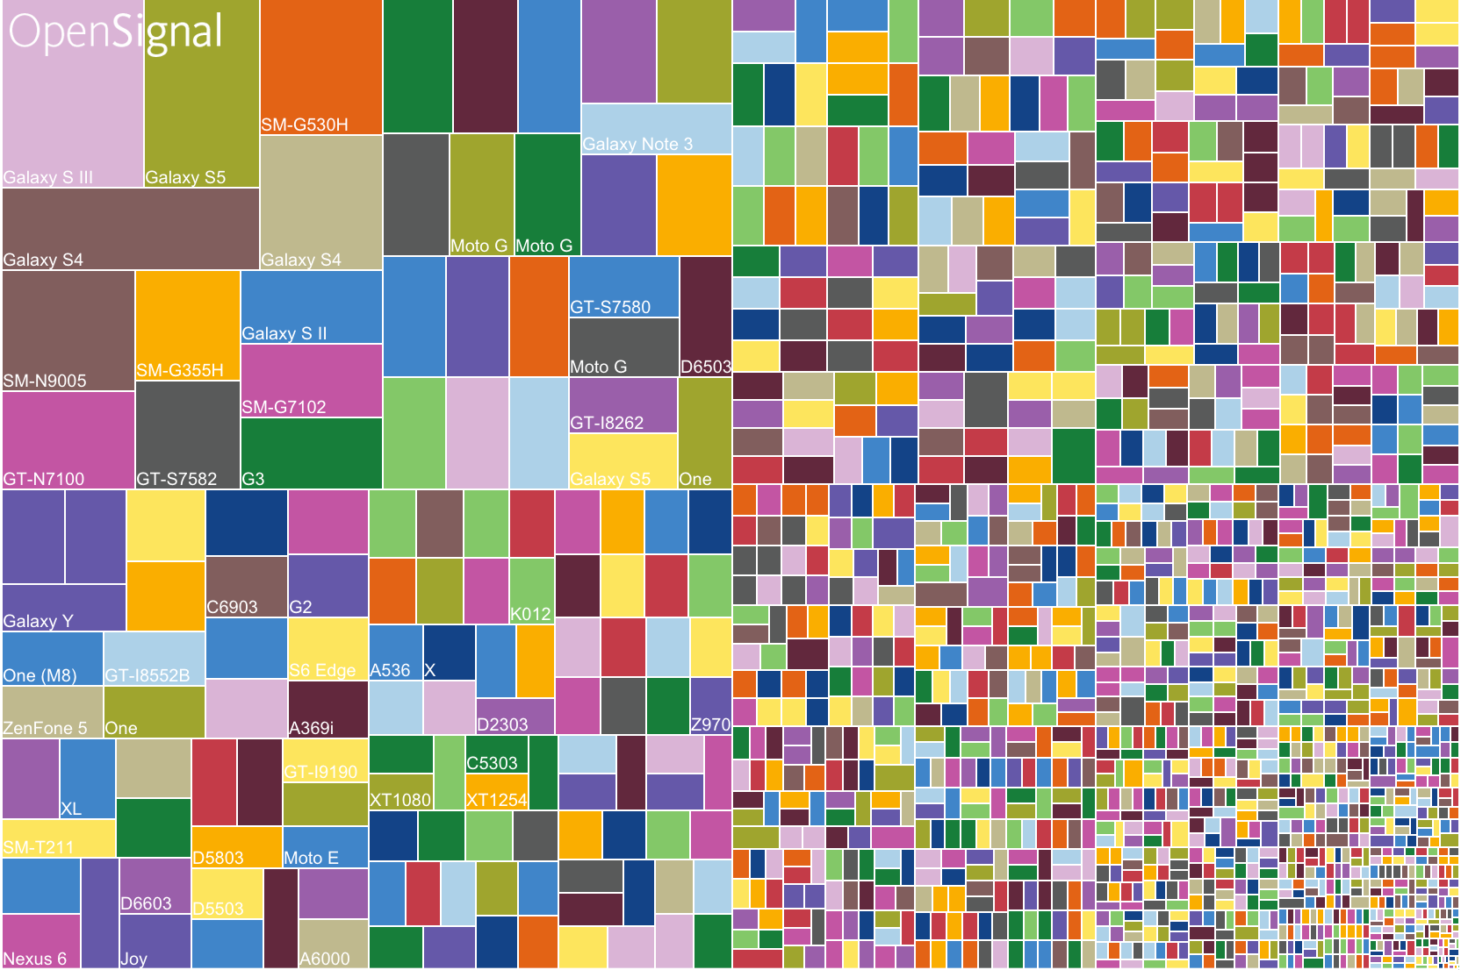
Android diversification

Slide 63
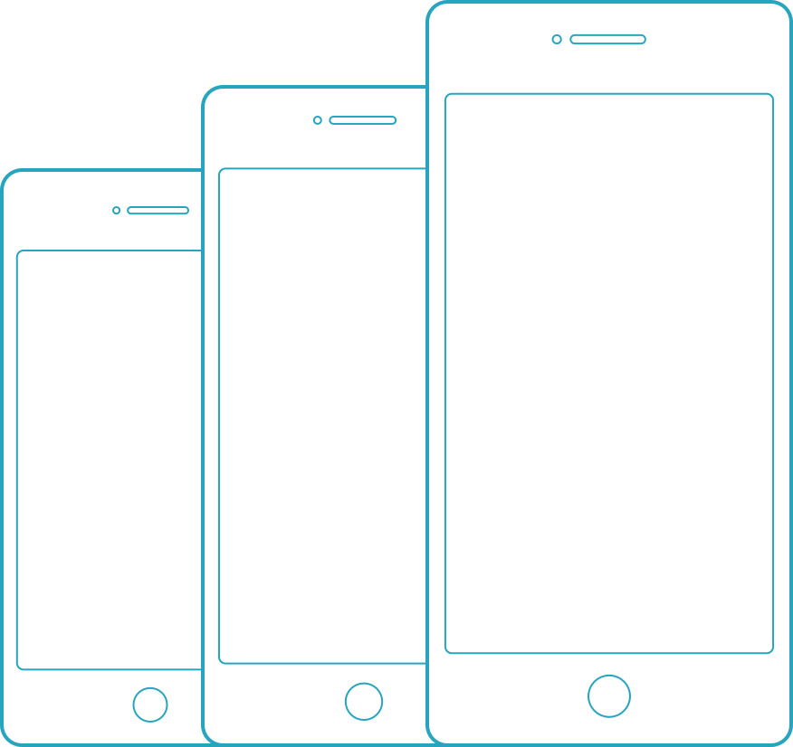
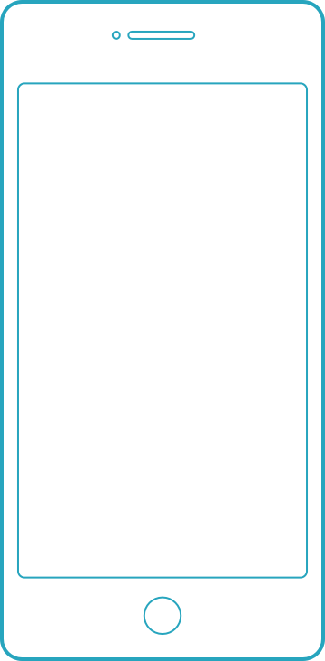
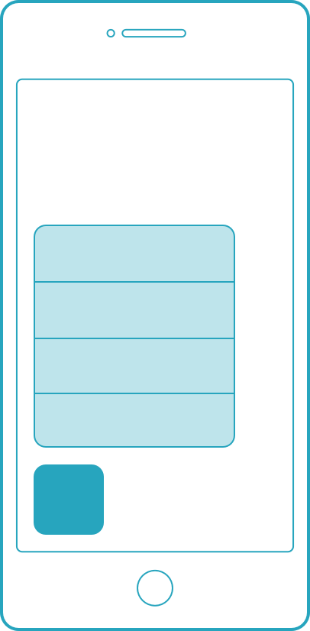
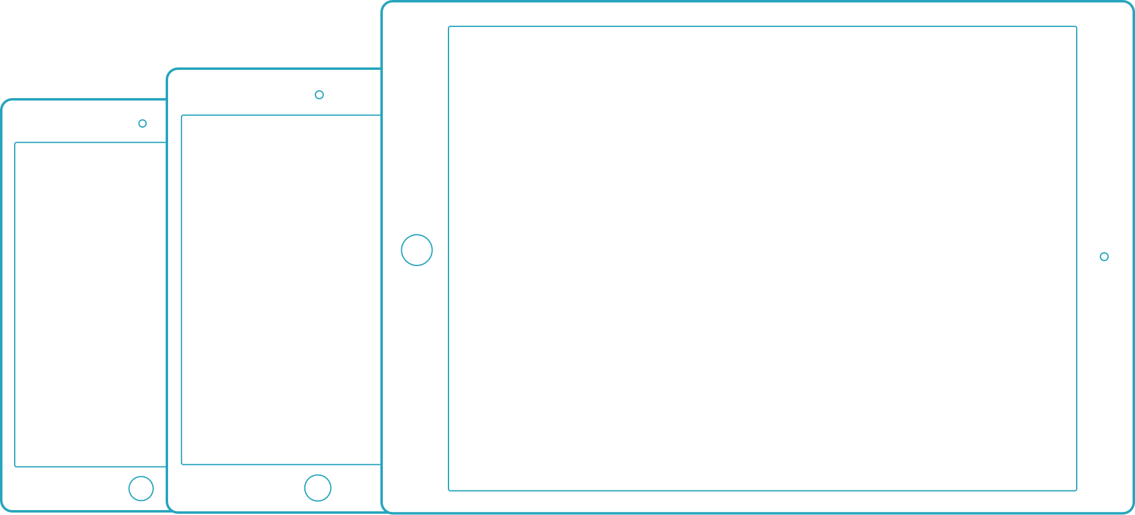
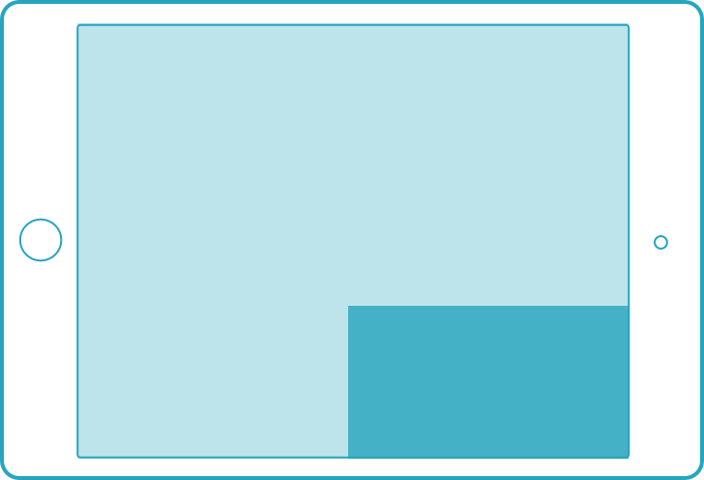
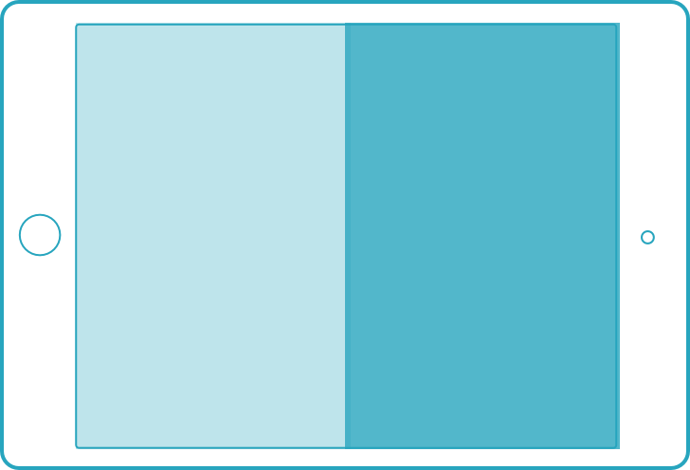
iOS diversification
3D Touch
Apple pencil
iPhones
iPod touch
iPad Pro only
iPhone 6s series only
iPads
Multi Tasking
Only select iPads
Form factors
iOS 9 features

Slide 64








App Complexity
Thousands of iOS and Android APIs
Public web APIs
Backend integrations
Third party libraries
Memory, CPU and network constraints
Notes:
The fragmentation isn’t just in the devices, but as we start to build on our applications you soon found out they are ever increasingly complex.

Slide 65








Tap
Scroll
Swipe
Pinch
Multi Finger
Text Entry
Rotation
GPS
Notes:
With a simple command you can simulate all of your users interactions to build out a great test suite that can be run over and over again.

Slide 66
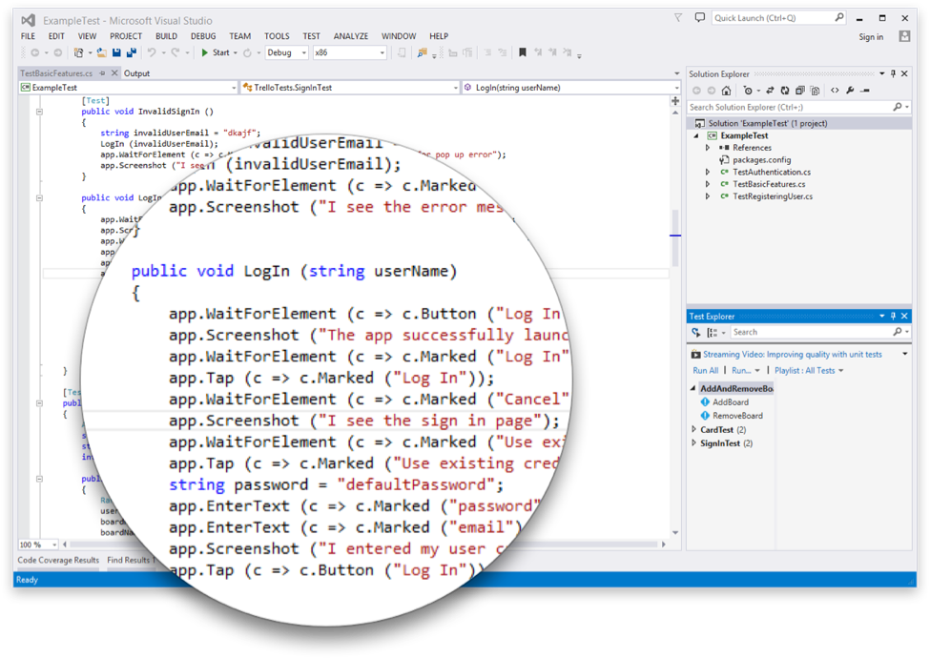
Introducing Xamarin.UITest
Create Automated User Interface tests all in C#
Upload to the Test Cloud or run against a Device or Simulator
Run directly from Visual Studio or Xamarin Studio
Freely available for testing on a Simulator*
Works on ANY app: Native, Hybrid, or Xamarin
Notes:
This is where Xamarin.UITest comes in to help with this shift. Xamarin.UITest is a framework that ties in directly to the Nunit testing framework to write the UI tests. You can even run them directly against a simulator for free to do regression tests on your applications.
Freely available for testing on a Simulator*

Slide 67
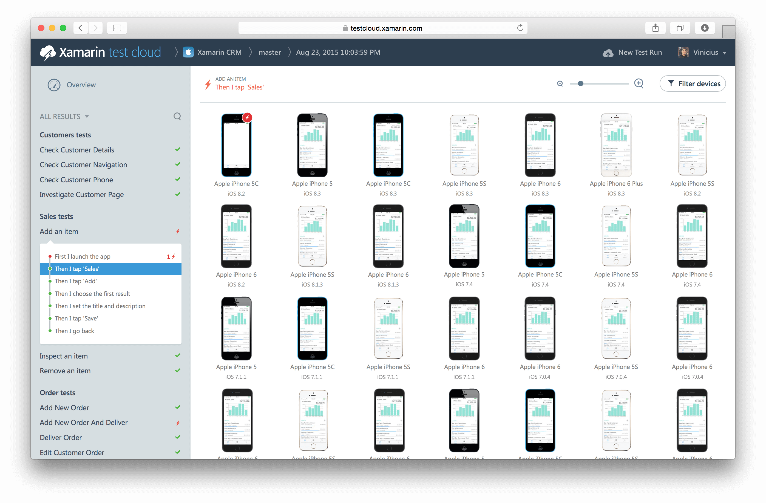
Xamarin Test Cloud: automated testing on thousands of devices
Notes:
Remote debugging på hvilken som helst device
Test Recorder
-Easily create tests with a tap of your app
-Copy out test or upload to test cloud

Slide 68
Xamarin – Your Complete Mobile Solution
BUILD
TEST
MONITOR
ACCELERATE
Notes:
Analytics and Crash Reporting

Slide 69

xamarin.com/insights
Notes:
Xamarin Insights is a new product from Xamarin, currently in preview for all of your apps to handle crash reporting and analytics.

Slide 70
Xamarin Insights – Real-time monitoring
Supports
✓ Xamarin.iOS
✓ Xamarin.Android
✓ Xamarin.Mac
✓ Windows Phone
✓ Windows Store
✓ Windows Desktop
Notes:
Xamarin.Insights, currently in preview, enables us to support all of our apps from a full cross platform API.

Slide 71
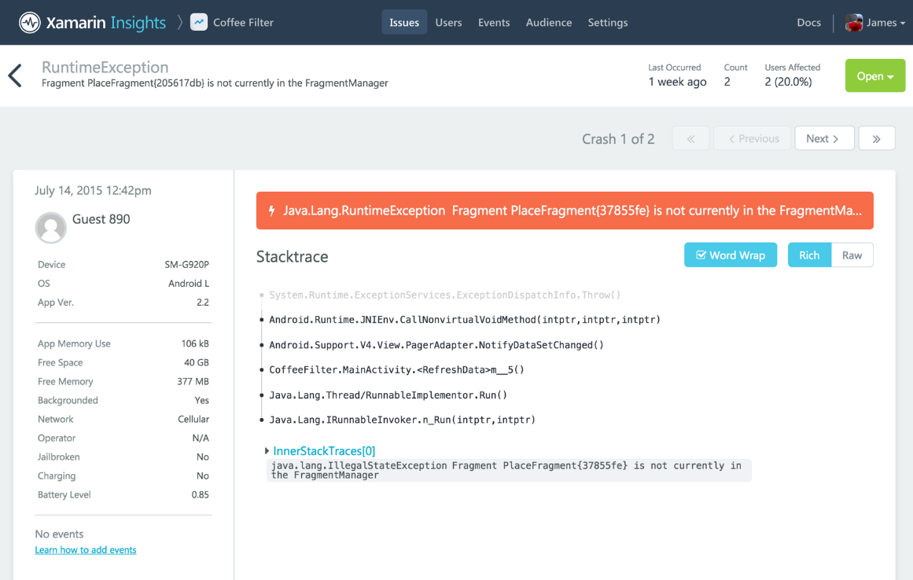
Xamarin Insights – Report
Automatically report any uncaught managed or native exception.
Report your own caught exceptions with simple cross-platform API.

Slide 72
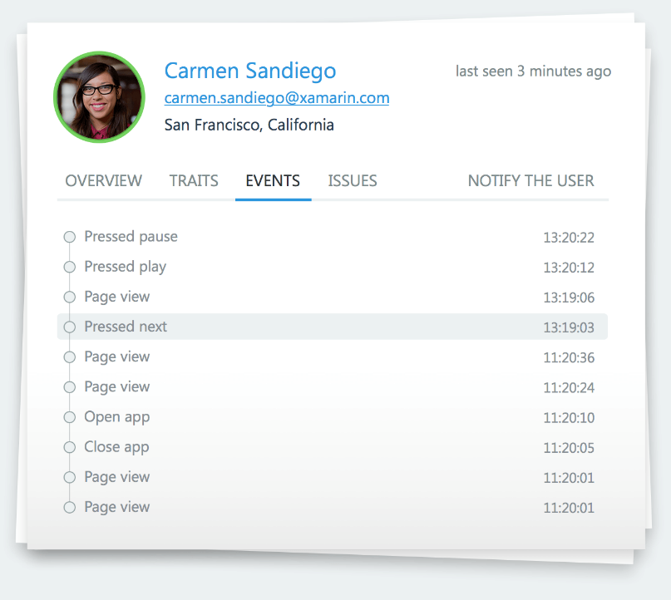
Xamarin Insights – Track
Track any event that occurs in your application.
Even track performance of how long an operation takes.

Slide 73
Xamarin Insights – Identify
Combine event tracking with user identification to resolve issues faster.

Slide 74




Xamarin Insights – Integrate
Simple integrations into popular services
for mission critical notifications.
Notes:
Xamarin.Insights, currently in preview, enables us to support all of our apps from a full cross platform API.

Slide 75

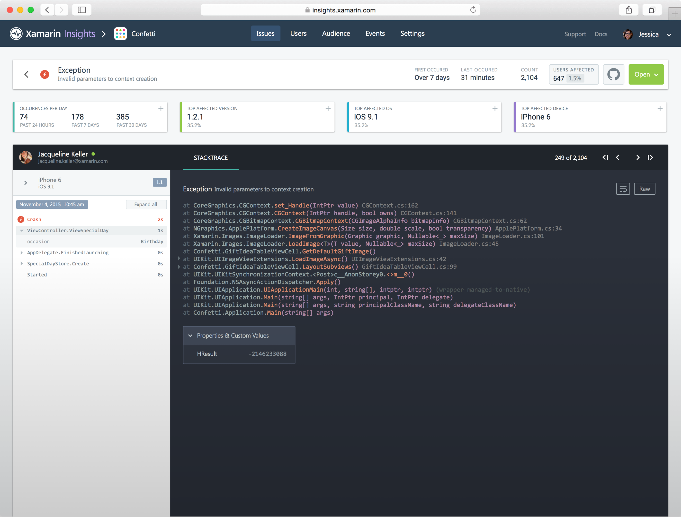
Introducing Xamarin Insights
//Crash Report
Insights.Report(exception);
//Feature Usage
Insights.Track(“Splash Page”);
//Timed Events
Insights.TrackTime(“TimeToSync”);
//User Sessions
Insights.Identify(“Steve”, user_traits);
Notes:
Insights Walkthrough

Slide 76
Demo https://insights.xamarin.com/app/HeartStarter-Beta2

Slide 77
Xamarin – Your Complete Mobile Solution
BUILD
TEST
MONITOR
ACCELERATE
Notes:
Xamarin is your complete mobile solution.
Xamarin Platform is usually what you hear about which is building native iOS, Android, Mac, and Windows Apps all in C#
However Xamarin offers a wide range of products for developers to go mobile including Test Cloud, Insights, and a way to learn all of mobile with University.

Slide 78
What’s Xamarin University?
Over 60 classes
Guest Lectures and office hours
Lightning Lectures: Bite size learning on specific topics
Certification: Be recognized
for being a
Mobile and
Xamarin expert
Reduced renewal pricing

Slide 79
Xamarin – Your Complete Mobile Solution
BUILD
TEST
MONITOR
LEARN

Slide 80
Get Started Today
xamarin.com
Notes:
Get started today with free 30 day trial of Xamarin at xamarin.com

Slide 81
Unrivaled Mobile Development Training
Live unlimited mobile development training from mobile experts, in your time-zone, on your schedule, and as often as you'd like.
Free 30 Day Trial - xamarin.com/university

Slide 82

evolve.xamarin.com
Notes:
Live Coding Environment
Supports:
iOS
Android
Mac
Xamarin.Forms
Write code and see it live before your eyes!
WORKBOOK, PREVIEWER

Slide 83
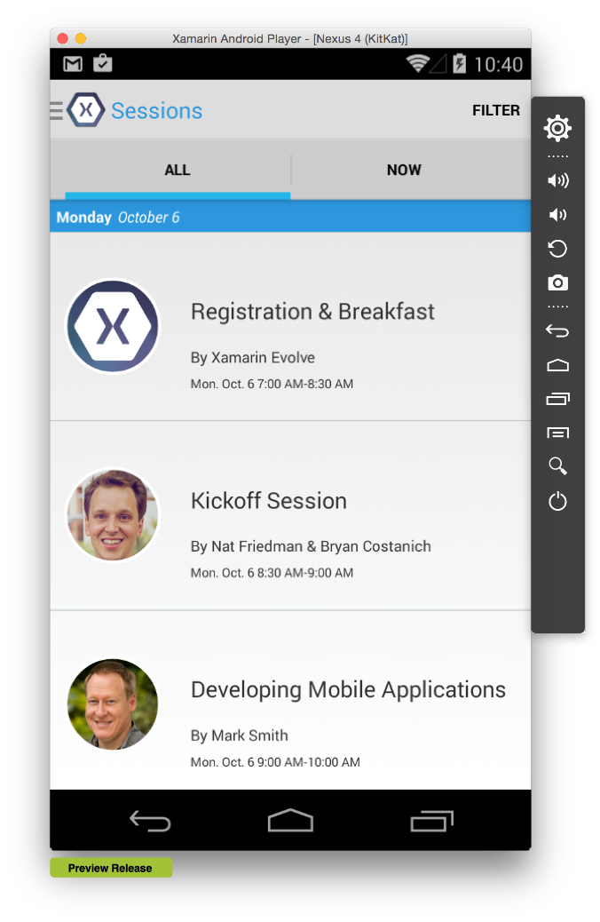
Xamarin Android & iOS Player
✓ Mac or PC
✓ Runs side-by-side Windows Phone Emulator
✓ Completely Free
Notes:
Of course, you can use any android emulator, even the ones built into Visual Studio 2015.

Slide 84

SMSLivräddare Case Study by Eirik Lie – Lead Application Architect

Slide 85
From No Mobile Experience to Success
No previous Xamarin experience
High demands for reliability and device support
Karolinska Institutt og SOS Alarm
http://www.umsalert.com/new-services/sms-lifesaver-app/

Slide 86
From No Mobile Experience to Success
With no mobile experience, team leveraged Visual Studio to create native iOS, Android app in 6 months.
Xamarin app replaced existing SMS service for better user experience, performance and accuracy.
70% code-sharing

Slide 87
Xamarin enables UMS to

Slide 88
Thank You! Questions?

